Slide 1
Accounting – The Language of Business
Neeraj Marathe
January 23, 2021

Slide 2



I am a ‘non-commerce’ student

Slide 3

It need not be that way

Slide 4


Why is accounting needed?!
That means you are out of money. What did you spend so much money on?
Hey Dad, missing you. How are you?
How mean! But ya you are right. ☹
I spent it on, you know.. Stuff.

Slide 5
What is expected from you?
Executive decision making
As management professionals, this is what you will be concerned with the most
But understanding how to get to this point is also most important
If financial statements are messed up, further steps become immaterial. But you need to understand that in the first place!
You need working knowledge of accounting, expert knowledge is optional
For those of you who plan of starting / joining their own business, however, a more in-depth knowledge of accounting is very important
Financial statement analysis
Prep of financial statements
Actual Accounting
Record Keeping

Slide 6

What is accounting?
Recording of various transactions of the business, based on certain rules
Rules; you have to remember by-heart, all else is pretty logical
It started with this; the single entry accounting system (Bahi-khata)
However, it was not something scalable and cross-checks were not there
So, the double entry accounting system was formulated
Every transaction has 2 parts; you give something and you get something
So it’s pretty logical that every transaction must be given 2 ‘effects’ in the books of accounts; one debit effect & one credit effect

Slide 7
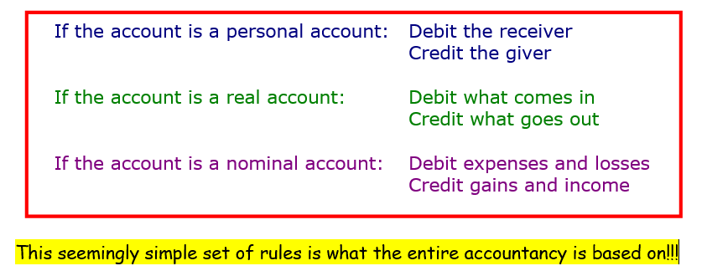
The double entry book keeping system
What you need to know: there are 3 types of accounts; personal, real and nominal. On what basis to classify them is part of theory
All accounts can be classified into 4 broad categories; income, expenditure, asset and liability. You just have to understand what is what; again, a bit of theory and a bit of practice

Slide 8
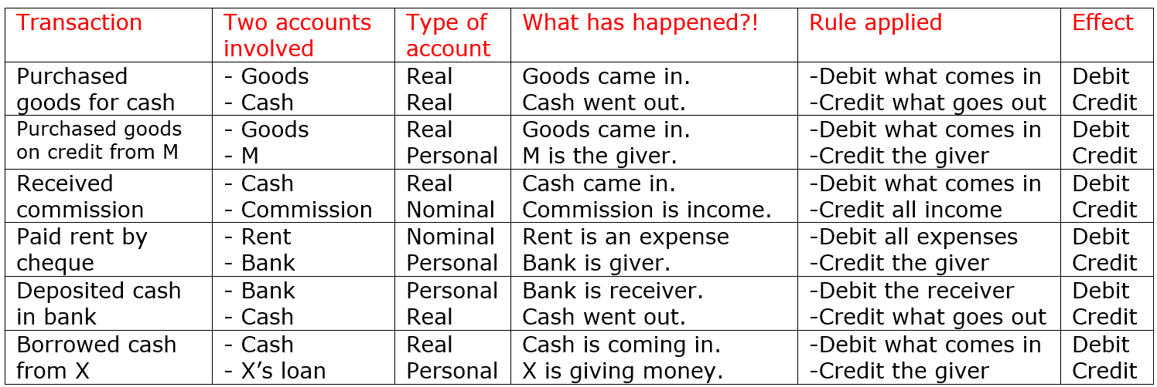
Some simple examples
It is all pretty mechanical, once you get a hang of it. Just be systematic and go step-by-step!

Slide 9
The accounting cycle
The accounting cycle starts with a transaction and ends with preparation of the financial statements; P&L, balance sheet and cash-flow
Essentially, the same thing is recycled and presented in different books in different ways to arrive at the final statements
The main parts of the cycle are
  Transaction (The beginning)
  Journal (A book of account)
  Ledger (A book of account)
  Trial balance (Essentially, a summary)
  Final accounts (Financial statements)
Let us see how

Slide 10
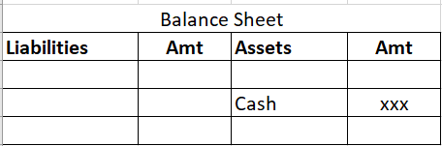
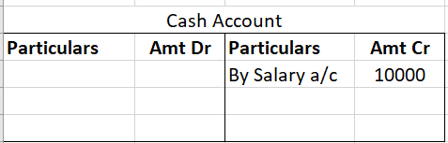
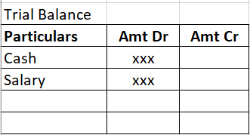
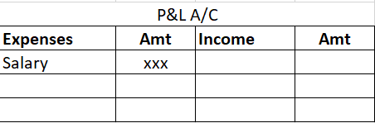
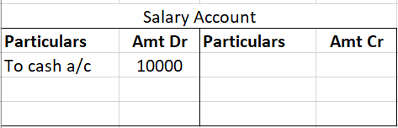
The accounting cycle
A/Cs involved:
Salary a/c
Cash a/c
Journal
Particulars | Amt Dr | Amt Cr
Salary a/c Dr | 10,000
To Cash a/c |  | 10,000
(Being paid salary in cash)
TRANSACTION
Paid salaries in cash Rs.10000/-
Same thing, just presented in different ways again and again!
Cash Flow Statement

Slide 11
P&L and Balance Sheet

Slide 12
Cash Flow Statement

Slide 13
Why accounting matters
The way you account for various items determines your profitability as well as assets/liabilities (P&L and Balance Sheet)
You can significantly change both, by clever use of accounting
Some examples
Let’s say you are manufacturing pumps. When should you record something as ‘sales’?
You are an IT company and you bill in $. You sent your client a bill for $100. On the day of billing, $1 = ₹75. The client transferred $100 after 30 days. That time, $1 = ₹70. You have to report your revenue in ₹. How much?
How long does a treadmill/other gym equipment last? Rs.100, depreciated for 10 years = Rs.10 depreciation per year. But depreciated for 4 years?!
Accounting Standards

Slide 14
Ratio analysis
Why ratio analysis?
By merely observing financial statements, one cannot understand the performance of the enterprise
The linkages and inter-connections become clear only after analysis and comparison
Ratio analysis is a systematic use of ratios to interpret/assess the performance and status of the enterprise
Ratios are meaningless without comparison

Slide 15
Ratio analysis
Ratio analysis is therefore, a quantitative analysis of financial statements
Ratios help us conduct inter-firm, intra-firm and industry comparison
Ratios help us detect frauds/red flags
Various readers of financial statements will give different importance to different ratios. Bankers, investors, company management…
Huge number of ratios… Balance sheet ratios, P&L ratios, connecting ratios!
Everyone will customize them to suit their own needs
In some cases, the formula may also be different

Slide 16
Some examples and how they help
Particulars | Year 1 | Year 2 | Year 3 | Year 4 | Year 5 | Year 6
Sales | 100 | 120 | 150 | 130 | 130 | 120
Profit after tax | 10 | 13.2 | 16.5 | 15.6 | 15.6 | 15.6
Simple Profit Margin ratio
Margin | 10% | 11% | 11% | 12% | 12% | 13%
Funda of Capital Employed and ROCE; PBIT (profit)
Particulars | Year 1 | Year 2 | Year 3 | Year 4 | Year 5 | Year 6
Capital Employed | 100 | 110 | 125 | 130 | 130 | 140
Profit | 10 | 12.1 | 13.75 | 15.6 | 15.6 | 18.2
ROCE tells you how efficiently you are using capital, which is a scarce resource
ROCE | 10% | 11% | 11% | 12% | 12% | 13%

Slide 17

Some examples and how they help
Particulars | Year 1 | Year 2 | Year 3 | Year 4 | Year 5 | Year 6
Sales Rs | 100 | 130 | 170 | 200 | 250 | 300
Profit Rs | 10 | 15 | 18 | 24 | 30 | 38
Profit Margin % | 10% | 12% | 11% | 12% | 12% | 13%
Debtors Rs | 20 | 30 | 45 | 60 | 90 | 110
Days | 73 | 84 | 97 | 110 | 131 | 134
Can anyone tell me what does ‘debtors’ mean?
Now what you say about this business?

Slide 18
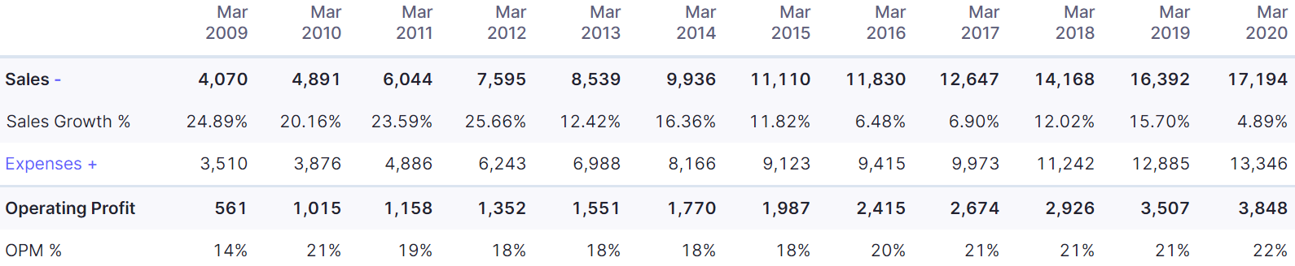
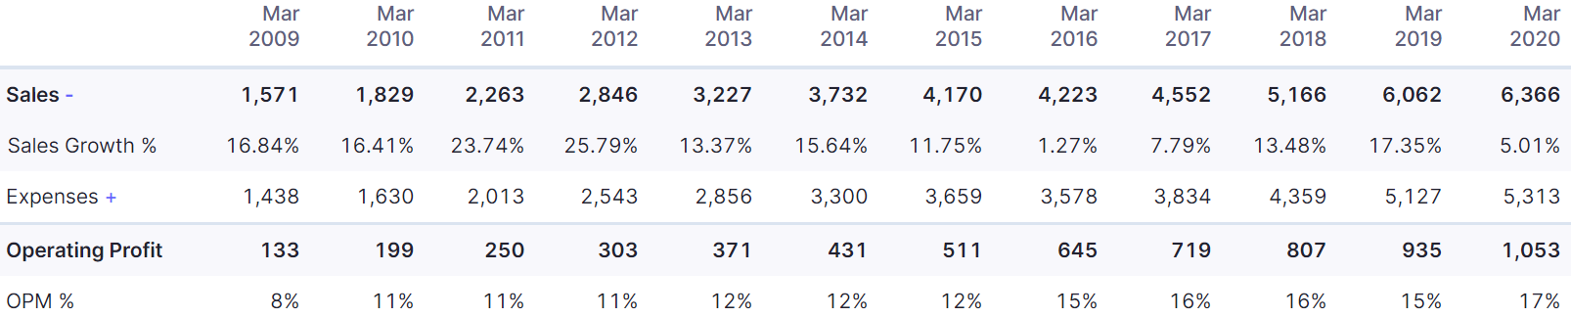
Some actual stuff
Asian Paints
Rs.250000 cr
Berger Paints
Rs.16000 cr

Slide 19
To sum it all up
Accounting, ratios and related topics are not hard, they just require effort and practice
Do not have any mind-blocks; just be systematic
These will be useful and practically applicable in real life; personally as well as professionally. It is not ‘just useless theory’
What we have covered is maybe 1%!
Some tips!
Start maintaining an account of your own expenses; it helps understand the topic, plus you will feel guilty too ☺
If you are interested in reading and learning more about accounting, pick up books by Indian authors; accounting norms differ in different countries

Slide 20


